Slide 1

NLP and Word Embeddings
Learning Objectives:
Explain how word embeddings capture relationships between words
Load pre-trained word vectors
Measure similarity between word vectors using cosine similarity
Use word embeddings to solve word analogy problems such as Man is to Woman as King is to ______.
Reduce bias in word embeddings
Create an embedding layer in Keras with pre-trained word vectors

Slide 2
NLP and Word Embeddings
Learning Objectives:
Describe how negative sampling learns word vectors more efficiently than other methods
Explain the advantages and disadvantages of the GloVe algorithm
Build a sentiment classifier using word embeddings
Build and train a more sophisticated classifier using an LSTM

Slide 3
NLP and Word Embeddings
1 Word representation
2 Using word embeddings
3 Properties of word embeddings
4 Embedding matrix
5 Learning word embeddings
6 Word2Vec
7 Negative sampling
8 GloVe word vectors
9 Sentiment classification
10 Debiasing word embeddings

Slide 4
NLP and Word Embeddings
Word representation

Slide 5
Word representation
In contrast to traditional one-hot vector representation, word embeddings are a technique to represent words in a higher dimensional space where each word is represented by a set of features and values.
While one-hot vectors treat each word separately and make it difficult for an algorithm to generalize across words, word embeddings allow an algorithm to recognize that words with similar meanings or connotations have similar feature values, even if they are not the same word.
Notes:
Word embeddings are a way of representing words in a higher dimensional space where each word is represented by a set of features and values. This is in contrast to the traditional one-hot vector representation where each word is represented by a vector with one in its own position and zeros elsewhere.
The weakness of the one-hot representation is that it treats each word as a thing unto itself, and it doesn't allow an algorithm to easily generalize across words. Word embeddings, on the other hand, allow an algorithm to recognize that words with similar meanings or connotations have similar feature values, even if they are not the same word.

Slide 6
Word representation
V = [a, aaron, …, zulu, <UNK>]
1-hot representation
Man (5391)
Woman (9853)
King Queen ^{Apple Orange} (4914) (7157) ⁽⁴⁵⁶⁾ ⁽⁶²⁵⁷⁾
I want a glass of ^{orange ______}
I want a glass of an apple ____
0
0
0
0
⋮ 1
⋮
0
0
0
0
0
0
0
⋮ 1
⋮
0
0
0
0
⋮
1
⋮ 0
0
0
0
0
0
0
0
⋮ 1
⋮
0
0
⋮ 1
⋮
0
0
0
0
0
0
0
0
0
0
⋮ 1
⋮
0

Slide 7
Featurized representation: word embedding
Consider an example of how word embeddings could be used to recognize that "orange juice" is a popular phrase and to generalize to other fruit juices, such as apple juice. With word embeddings, words like man and woman or king and queen would be represented as vectors that are closer to each other in the feature space, while words like apple and orange would be represented as vectors that are also closer to each other.

Slide 8
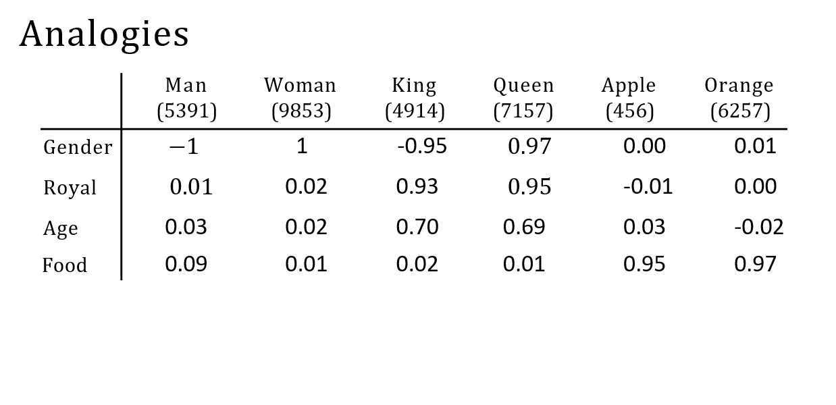
Featurized representation: word embedding
I want a glass of orange . I want a glass of apple .

Slide 9
Visualizing word embeddings
The features learned in word embeddings may not have an easy-to-interpret interpretation, but they will allow an algorithm to recognize the relationships between different words more easily. The embeddings can also be visualized in lower dimensions to see how words cluster together based on their feature values.
Word embeddings have been one of the most important ideas in NLP and have allowed for significant improvements in tasks such as language translation, sentiment analysis, and text classification.

Slide 10
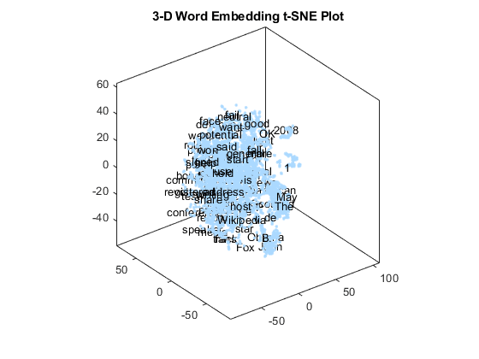

Visualizing word embeddings
man woman
king
queen
dog
cat
fish
_{grap} apple
e
three ^{four}
one two
orange

Slide 11
NLP and Word Embeddings
Using word embeddings

Slide 12
Named entity recognition example
How can featurized representations of words, known as word embeddings, be used in NLP applications, specifically named entity recognition?
Word embeddings can be learned from large text corpuses, which can be used to identify relationships between words, such as the fact that "orange" and "durian" are both fruits. This information can then be used to improve the accuracy of named entity recognition, even when the task includes words that were not present in the original training set.

Slide 13
Named entity recognition example
1
1
0
0
0
0
Sally
Johnson
is
an
orange
farmer
Robert
Lin
is
an
apple
farmer

Slide 14
Transfer learning and word embeddings
The benefits of using word embeddings for transfer learning, where knowledge learned from a larger dataset can be applied to a smaller, related task. Word embeddings can also be used to represent words using lower-dimensional feature vectors, which can be faster and more efficient than traditional one-hot vectors.
Word embeddings have been useful for many NLP tasks, including named entity recognition, text summarization, co-reference resolution, and parsing. However, they may be less useful for language modeling and machine translation when a large dataset is available.

Slide 15
Transfer learning and word embeddings
Learn word embeddings from large text corpus. (1-100B words) (Or download pre-trained embedding online.)
Transfer embedding to new task with smaller training set. (say, 100k words)
Optional: Continue to finetune the word embeddings with new data.

Slide 16
Relation to face embeddings
While the concepts are similar, there are differences between word embeddings and face encodings in how the algorithms are applied due to the fixed vocabulary in NLP. The terms "encoding" and "embedding" are often used interchangeably in these contexts.

Slide 17
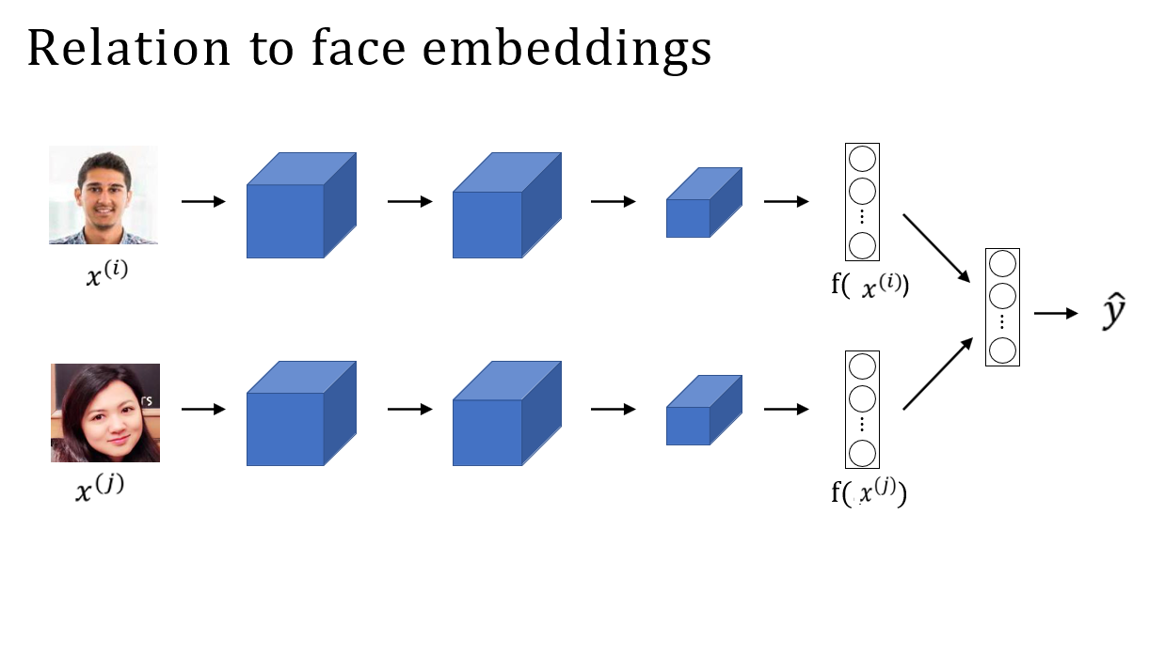

Slide 18
NLP and Word Embeddings
Properties of word
embeddings

Slide 19
Analogies
Word embeddings in NLP capture semantic relationships in a high-dimensional space, enabling analogy reasoning. For instance, by manipulating vector representations of "man," "woman," "king," and "queen," we can automatically solve analogies like "man is to woman as king is to what?" This involves subtracting the gender difference vector from "king" and finding the word closest to the result, which, in this case, is "queen."
Notes:
Word embeddings are a powerful tool in natural language processing (NLP) applications because they capture the semantic relationships between words in a high-dimensional space. One of the fascinating properties of word embeddings is that they can be used for analogy reasoning. For example, given the analogy "man is to woman as king is to what?", we can use the vector representations of the words "man," "woman," "king," and "queen" to solve the analogy automatically.
To do this, we subtract the vector representation of "man" from the vector representation of "woman" to get a vector that represents the gender difference. Similarly, we subtract the vector representation of "king" from the vector representation of "queen" to get another vector that represents the gender difference. Then, we try to find a word vector that, when we subtract the gender difference vector from the vector representation of "king" and add the gender difference vector to it, is closest in similarity to the vector representation of that word. In this case, the closest word vector is "queen."

Slide 20

Analogies
 | Man | Woman | King | Queen | Apple | Orange
 | (5391) | (9853) | (4914) | (7157) | (456) | (6257)
Gender | −1 | 1 | -0.95 | 0.97 | 0.00 | 0.01
Royal | 0.01 | 0.02 | 0.93 | 0.95 | -0.01 | 0.00
Age | 0.03 | 0.02 | 0.70 | 0.69 | 0.03 | -0.02
Food | 0.09 | 0.01 | 0.02 | 0.01 | 0.95 | 0.97

Slide 21
Analogies using word vectors
One of the remarkable results of word embeddings is the generality of the analogy relationships they can learn. For example, they can learn analogies such as "man is to woman as boy is to girl," "Ottawa is to Canada as Nairobi is to Kenya," "big is to bigger as tall is to taller," and "yen is to Japan as ruble is to Russia." These relationships can be learned by running a word embedding learning algorithm on a large text corpus.

Slide 22
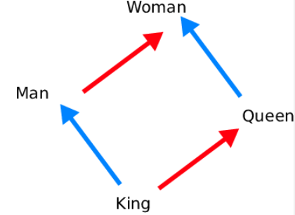

Analogies using word vectors
man
woman
dog
king
cat
queen
fish
three
four one
apple
grape
orange
two
Find word w : argmax

Slide 23
Cosine similarity
The most commonly used similarity function for measuring the similarity between two vectors in the high-dimensional space is cosine similarity. Cosine similarity measures the cosine of the angle between the two vectors and ranges from -1 to 1, where 1 indicates that the two vectors are identical, 0 indicates that the two vectors are orthogonal, and -1 indicates that the two vectors are pointing in opposite directions.

Slide 24
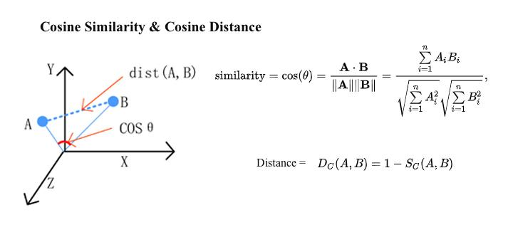
Cosine similarity
³⁴⁵⁽⁽,^{, (}/0+1 ⁻ ⁽)*+ ⁺ ⁽,-)*+⁾
Man:Woman as Boy:Girl Ottawa:Canada as Nairobi:Kenya Big:Bigger as Tall:Taller Yen:Japan as Ruble:Russia

Slide 25
Properties of word embeddings
Overall, word embeddings provide a way to capture the semantic relationships between words in a high-dimensional space, and analogy reasoning is just one of the many applications that can be built on top of them.

Slide 26
NLP and Word Embeddings
Embedding matrix

Slide 27
Embedding matrix
Learning a word embedding involves an embedding matrix, E, for a vocabulary of 10,000 words. Each column corresponds to an embedding for a word.
One-hot encoding, a 10,000-dimensional vector, represents each word.
To get the embedding vector for a word, multiply E by its one-hot vector, resulting in a 300-dimensional vector.
The notation E 6257 represents the embedding vector for the word at index 6257 in the vocabulary.
Notes:
When we implement an algorithm to learn a word embedding, what we end up learning is an embedding matrix. Let's say we have a vocabulary of 10,000 words, including an unknown word token. We will learn an embedding matrix E, which will be a 300-dimensional by 10,000 (or 10,001) dimensional matrix. The columns of this matrix correspond to the different embeddings for each of the 10,000 (or 10,001) words in our vocabulary. For example, if Orange was word number 6257 in our vocabulary, the 6257th column of the embedding matrix would represent the embedding vector for Orange.
We will use the one-hot encoding representation for each word in our vocabulary, which is a 10,000-dimensional vector with a one in the position corresponding to the word and zeros everywhere else. So, the one-hot vector for Orange would be a vector with a one in position 6257 and zeros everywhere else.
To compute the embedding vector for a given word, we can simply multiply the embedding matrix E by the one-hot vector for that word. The result will be a 300-dimensional vector, where each element corresponds to the weight of that dimension in the embedding for that word. For example, to compute the first element of the embedding vector for Orange, we would multiply the first row of the matrix E with the one-hot vector for Orange. Since all elements in the one-hot vector are zero except for the 6257th element, the result will be zero for all elements except the 6257th, which will be the weight of that dimension in the embedding vector for Orange. We can repeat this process for all dimensions of the embedding vector to obtain the complete embedding vector for a given word.
The notation we will use to represent the embedding vector for a given word will be E 6257, where 6257 is the index of the word in our vocabulary.

Slide 28
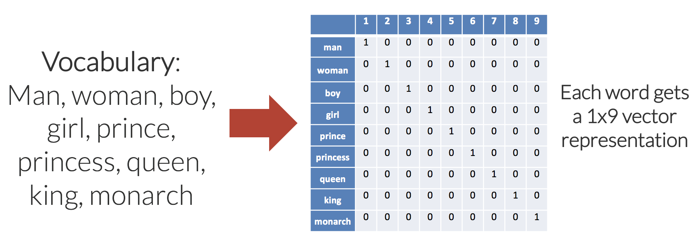
Embedding matrix
In practice, use specialized function to look up an embedding.

Slide 29
NLP and Word Embeddings
Learning word
embeddings

Slide 30
Neural language model
Word embeddings involve a 300-dimensional by 10,000-dimensional (or 10,001) embedding matrix. Columns represent word embeddings.
In a neural language model, the network predicts the next word in a sequence. Input words are represented by embedding vectors, obtained by multiplying a one-hot vector with the embedding matrix. The neural network's softmax layer classifies among 10,000 possible vocabulary outputs for the final word.
Notes:
Word embeddings are learned by constructing an embedding matrix, which is a 300-dimensional by 10,000-dimensional matrix (or 10,001 if there is an unknown word token). The columns of the matrix correspond to different embeddings for each of the words in the vocabulary, and a one-hot vector is used to select a specific column for a specific word.
Consider a neural language model as an example of how to use a neural network to learn word embeddings. The neural network is trained to predict the next word in a sequence given a set of input words. The input words are represented as embedding vectors, which are obtained by multiplying a one-hot vector with the embedding matrix. The neural network layer then feeds into a softmax layer that classifies among the 10,000 possible outputs in the vocabulary for the final word.

Slide 31
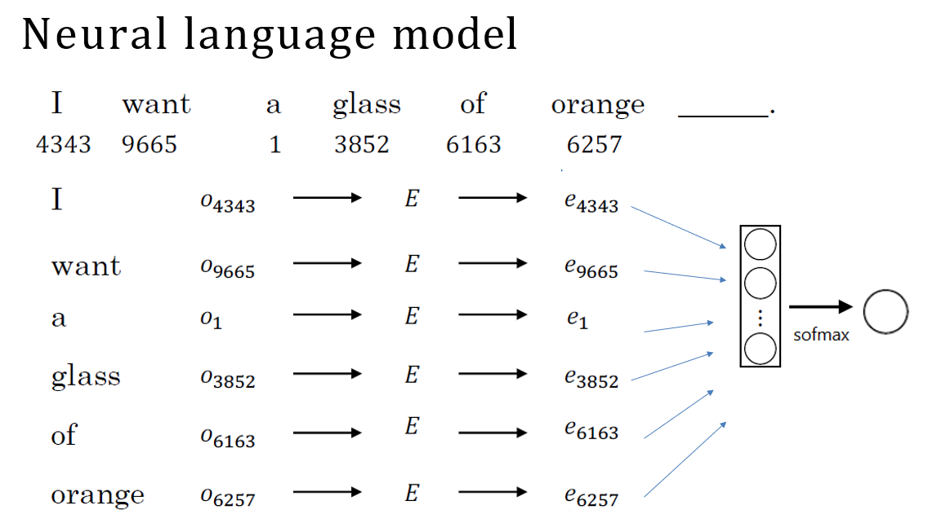

Slide 32
Other context/target pairs
This algorithm, successful for learning word embeddings, has simpler alternatives.
Researchers explored various contexts, like words before or around the target word, constructing learning problems for neural networks to predict the target word and learn meaningful embeddings. The next section delves into the Word2Vec model.
Notes:
This algorithm is one of the earlier and pretty successful algorithms for learning word embeddings, but researchers have since discovered even simpler algorithms that also give good results.
Researchers have experimented with different types of contexts to learn word embeddings, including a few words before the target word, the four words on the left and right, one previous word, or a nearby one word. These different contexts can be used to construct a learning problem that feeds into a neural network to predict the target word, and this process can be used to learn meaningful word embeddings. The next section will discuss the Word2Vec model in more detail.

Slide 33




Other context/target pairs
I want a glass of orange juice to go along with my cereal.
Context: Last 4 words.
4 words on left & right Last 1 word
Nearby 1 word

Slide 34
NLP and Word Embeddings
Word2Vec

Slide 35
Word2Vec
The Word2Vec algorithm is a simpler and more efficient way of learning these types of embeddings. The skip-gram model is used in Word2Vec, and it works by creating supervised learning problems by selecting a context word and a target word within a certain window. The goal of this is not to do well on the supervised learning problem but to learn good word embeddings.

Slide 36
Skip-grams
Skip-gram uses a softmax unit to predict a target word within a window using the input context word's embedding vector.
The softmax unit, with parameters for each target word, employs negative log likelihood as the loss function.
The computational speed issue arises due to the need for a sum over the entire vocabulary during probability evaluation.
A solution is a hierarchical softmax classifier, organizing classifiers in a tree to scale logarithmically with vocabulary size rather than linearly.
Notes:
The skip-gram model uses a softmax unit to take the embedding vector for the input context word and predict a target word within a certain window.
The softmax unit has parameters associated with each target word, and the loss function for softmax is the negative log likelihood.
However, the primary problem with using this algorithm is computational speed because every time the probability is evaluated, it requires a sum over all words in the vocabulary.
A solution to this problem is to use a hierarchical softmax classifier, where the tree of classifiers can be developed so that the common words are on top and less common words are buried deeper in the tree. This classifier scales like log of the vocabulary size rather than linear in vocabulary size.

Slide 37



Skip-grams
I want a glass of orange juice to go along with my cereal.

Slide 38
Model
The skip-gram model is one of two versions of the Word2Vec model, with the other being the continuous backward model (CBow), which uses the surrounding words to predict the middle word.
The key problem with the skip-gram model is that the softmax step is very expensive to calculate, an algorithm that modifies the training objective is presented to make it run much more efficiently and learn much better word embeddings.

Slide 39
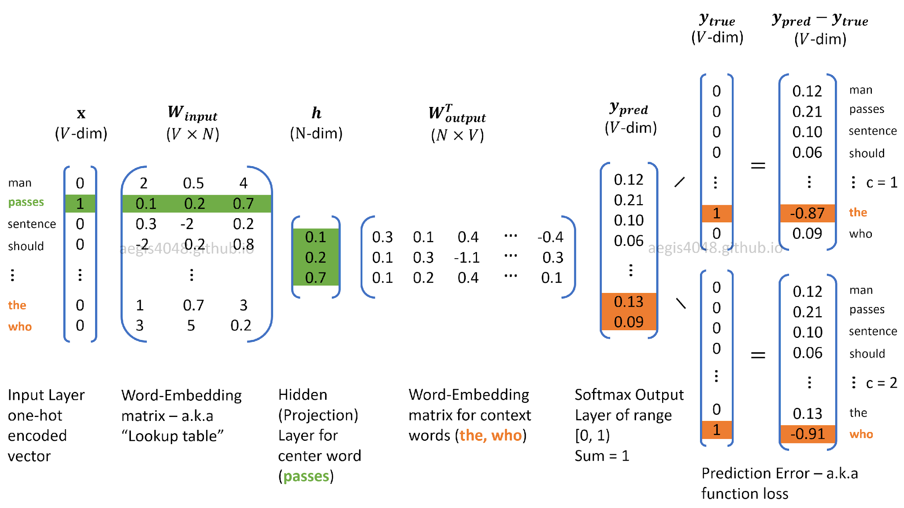
Model

Slide 40
Problems with softmax classification
Another problem is how to sample the context C.
Sampling uniformly at random results in some words appearing extremely frequently and dominating the training set, while others appear less often. The distribution of words pc is not taken entirely uniformly at random for the training set, and instead, different heuristics can be used to balance out common words and less common words.

Slide 41
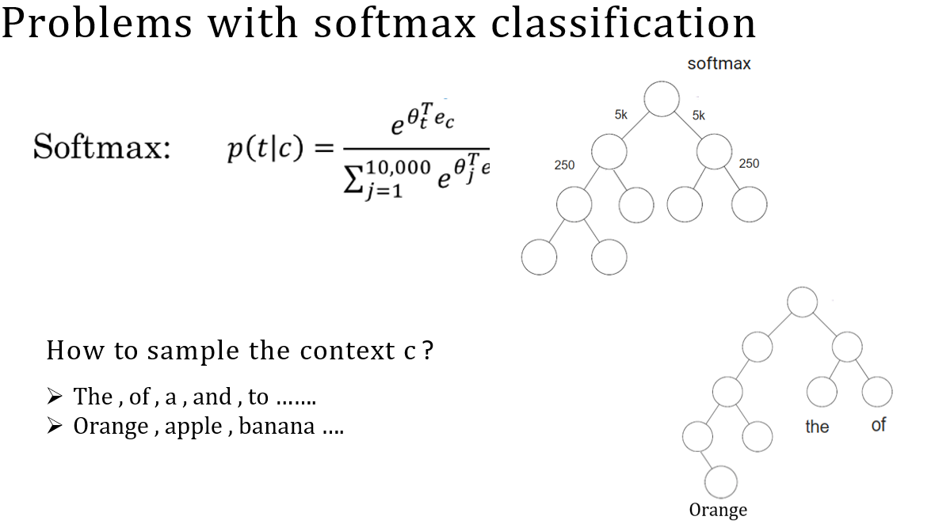

Slide 42
NLP and Word Embeddings
Negative sampling

Slide 43
Defining a new learning problem
How can the negative sampling technique be used to learn word embeddings efficiently?
Negative sampling creates a supervised learning problem where the task is to predict if a pair of words is a context-target pair or not. For instance, given a pair of words like orange and juice, the model has to predict if they appear together or not. If they appear together, the label is 1, and if they don't, the label is 0. To generate negative examples, the same context word is used, and a random word is chosen from the dictionary. The negative examples are labeled 0.

Slide 44
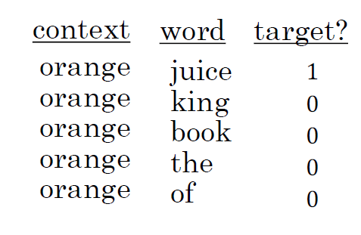
Defining a new learning problem
I want a glass of orange juice to go along with my cereal.
K = 5 – 20 Small datasets
K = 2 – 5 Large datasets

Slide 45
Model
To define the model, a logistic regression model is used. The chance of the label being 1 is modeled using a regression model. The specific formula used is sigmoid applied to the dot product of two vectors, one vector for the context word and another for the target word. The parameters are learned during training.
The computation cost of the negative sampling algorithm is much lower than that of the Softmax model because instead of updating a giant Softmax classifier, only k + 1 binary classification problems are updated on each iteration. K represents the number of negative examples. It is suggested that k should be 5 to 20 for smaller data sets and 2 to 5 for larger data sets.

Slide 46
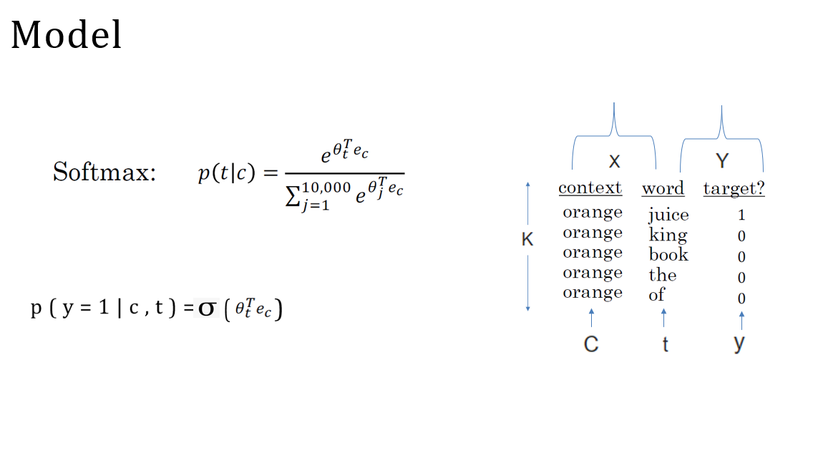

Slide 47
Selecting negative examples
How can negative examples be sampled to train the model?
Sampling from the empirical frequencies or uniformly at random from the dictionary is not recommended. Instead, a heuristic value is suggested, which is a little bit in between the two extremes. Negative examples are sampled proportional to the frequency of a word to the power of three-fourths.
There are open source implementations and pre-trained word vectors available online that can be used as a starting point for NLP problems. The next section will introduce the Glove algorithm, which is another word embedding learning algorithm.

Slide 48
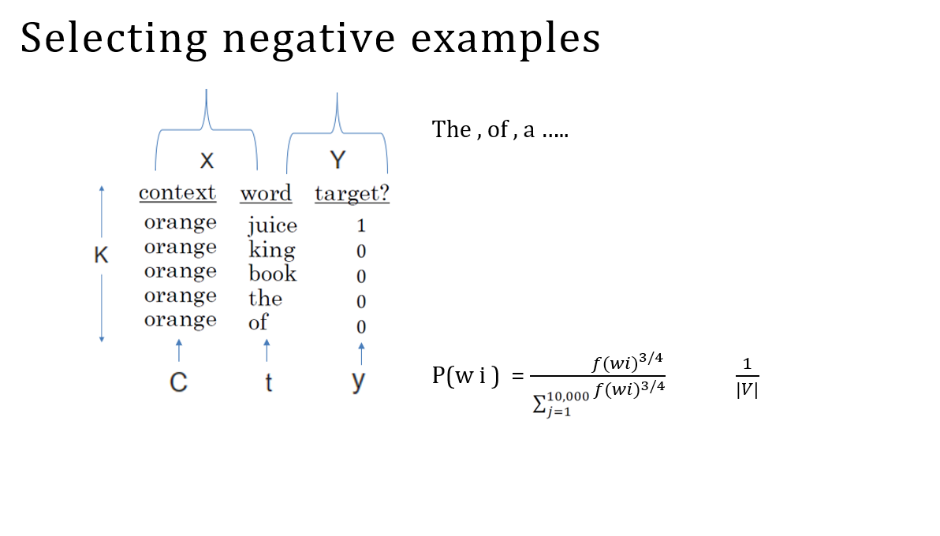

Slide 49
NLP and Word Embeddings
GloVe word vectors

Slide 50
GloVe (global vectors for
word representation)
The GloVe algorithm is another algorithm for computing word embeddings that was created by Jeffrey Pennington, Richard Socher, and Chris Manning.
GloVe stands for "global vectors for word representation."
The algorithm starts by making explicit the pairs of words that appear in close proximity to each other in a text corpus by counting how many times a word i appears in the context of a different word j. The count X_ij captures how often words i and j appear with each other or close to each other. The GloVe model optimizes the difference between theta_i transpose e_j and log of X_ij squared using gradient descent.

Slide 51
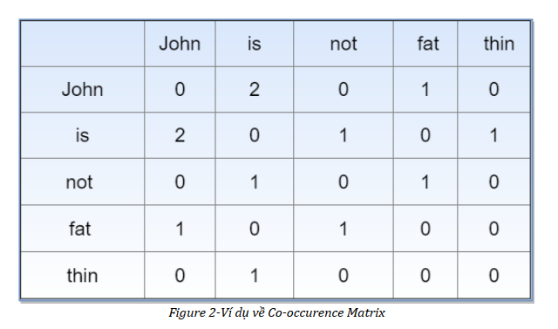
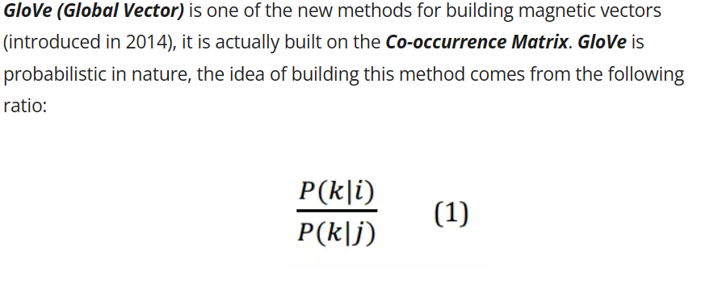
GloVe (global vectors for
word representation)

Slide 52
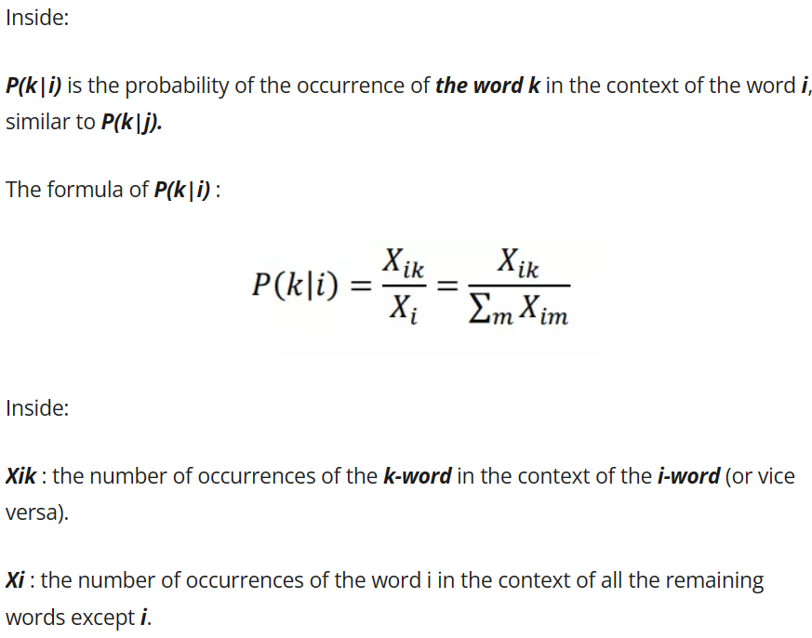
GloVe (global vectors for word representation)

Slide 53
Model
The goal is to learn vectors for effective word co-occurrence prediction. If X_{ij} = 0, the log of 0 is undefined, so an extra weighting term is added to sum only over co-occurred word pairs.
Various heuristics for the weighting function F balance meaningful computation for infrequent words without excessive weight. In the GloVe algorithm, roles of θ and e are symmetric. Training involves initializing θ and e uniformly, minimizing the objective with gradient descent, and averaging for a word afterward.
Despite potentially arbitrary linear transformations, the parallelogram map still works for figure analogies.
Notes:
The objective is to learn vectors so that their end product is a good predictor for how often two words occur together. If X_ij is equal to zero, the log of 0 is undefined, and we add an extra weighting term to sum only over the pairs of words that have co-occurred at least once in that context-target relationship.
There are various heuristics for choosing this weighting function F that gives meaningful computation to infrequent words but does not give them too much weight. The roles of theta and e are completely symmetric in the GloVe algorithm. One way to train the algorithm is to initialize theta and e both uniformly around gradient descent to minimize its objective, and then when done, take the average for a given word.
However, the individual components of the embeddings may not be interpretable. Despite this potentially arbitrary linear transformation of the features, the parallelogram map that works for figure analogies still works.

Slide 54
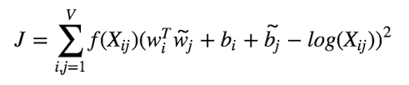
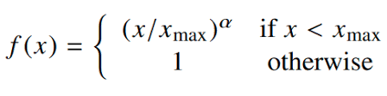
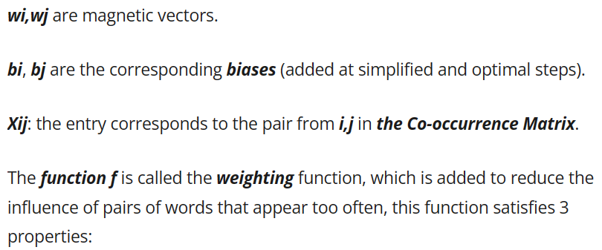
Model
Minimize: Σ¹⁰⁰⁰⁰_{i=1}Σ¹⁰⁰⁰⁰_{j=1}f(X_{ij})(𝜃^{T}_{i}e_{j} + b_{i} + b_{j’} - logX_{ij})²
e^{(found)}_{ω} = (e_{ω} + 𝜃_{ω})/2

Slide 55

A note on the featurization view of word embeddings
Man Woman King Queen (5391) (9853) (4914) (7157)
Gender Royal Age Food
−1 | 1 | -0.95 | 0.97
0.01 | 0.02 | 0.93 | 0.95
0.03 | 0.02 | 0.70 | 0.69
0.09 | 0.01 | 0.02 | 0.01

Slide 56
NLP and Word Embeddings
Sentiment
classification

Slide 57
Sentiment classification problem
Sentiment classification in NLP analyzes text to determine positive or negative opinions. Limited labeled training data is a challenge, but word embeddings mitigate this by enabling learning from a larger text corpus.
A common approach uses one-hot encoding for words, multiplied by an embedding matrix to get word embeddings. These are then averaged or summed to create a fixed-length feature vector for softmax sentiment prediction.
Notes:
Sentiment classification is a task in natural language processing (NLP) that involves analyzing a piece of text to determine whether the author has a positive or negative opinion of a particular subject. For example, given a restaurant review, the task is to predict whether the review is positive or negative based on the text. One of the main challenges in sentiment classification is that labeled training data may be limited, which can make it difficult to train an accurate model. However, word embeddings can help address this issue by allowing models to learn from a much larger text corpus and generalize to new words.
One common approach to sentiment classification involves using a one-hot encoding to represent each word in the text and then multiplying it by an embedding matrix to obtain a corresponding word embedding. These embeddings are then averaged or summed to obtain a fixed-length feature vector, which can be passed to a softmax classifier to predict the sentiment label.

Slide 58
Sentiment classification problem
x
The dessert is excellent.
Y
Service was quite slow.
Good for a quick meal, but nothing special.
Completely lacking in good taste, good service, and good ambience.

Slide 59
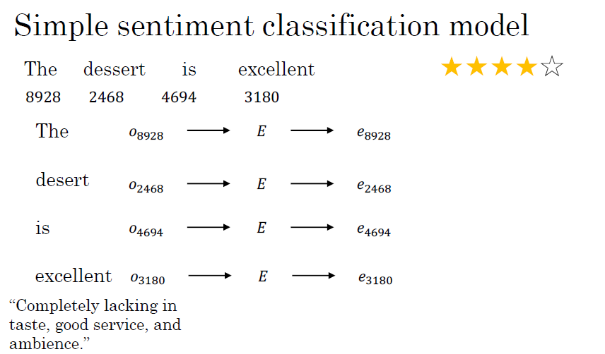

Slide 60
RNN for sentiment classification
While the one-hot encoding and embedding matrix approach for sentiment classification lacks consideration of word order, a more effective solution involves using a recurrent neural network (RNN). RNNs process text sequentially, capturing temporal dependencies and improving accuracy by considering word order.
In summary, word embeddings enhance sentiment classification, and RNNs enable better modeling of language nuances for more accurate predictions.
Notes:
However, this approach has limitations because it ignores the order of words in the text. For example, if a review contains both positive and negative words, the sentiment label may be inaccurate because the model is unable to capture the nuances of the language. To overcome this limitation, a more sophisticated approach involves using a recurrent neural network (RNN) to process the text sequentially and capture the temporal dependencies between words. This approach can improve the accuracy of sentiment classification by taking the order of words into account.
Overall, word embeddings provide a powerful tool for sentiment classification, enabling models to learn from larger data sets and generalize to new words. By using RNNs to process text, models can capture the nuances of language and provide more accurate sentiment predictions.

Slide 61
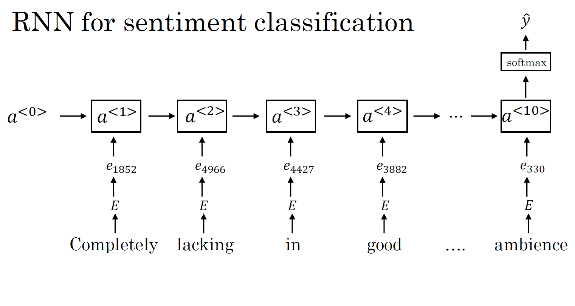

Slide 62
NLP and Word Embeddings
Debiasing word
embeddings

Slide 63
The problem of bias in word embeddings
Word embeddings represent words as vectors in high-dimensional space, applied in NLP tasks like sentiment analysis and translation.
Despite their utility, word embeddings may inherit biases from the training text, exemplified by gender stereotypes. To mitigate bias, ideas for reduction or elimination are proposed in word embeddings.
Notes:
Word embeddings are a type of natural language processing technique that involves representing words as vectors in a high-dimensional space. These embeddings are used to perform various NLP tasks, such as sentiment analysis, language translation, and text classification.
However, word embeddings can also reflect biases that exist in the text used to train the model. For example, a word embedding might output "Man:Computer_Programmer" as "Woman:Homemaker," reflecting a gender stereotype. To address this issue, the authors of the paper referenced in the section propose a set of ideas for reducing or eliminating bias in word embeddings.

Slide 64
The problem of bias in word embeddings
Man:Woman as King:Queen
Man:Computer_Programmer as Woman: Homemaker Father:Doctor as Mother: Nurse
Word embeddings can reflect gender, ethnicity, age, sexual orientation, and other biases of the text used to train the model.

Slide 65
Addressing bias in word embeddings
To mitigate bias in word embeddings, the first step is identifying the bias direction, such as the gender difference between "he" and "she."
Next, non-definitional words like "grandmother" are projected onto this bias direction to reduce their gender component.
Finally, pairs like "grandmother" and "grandfather" are equalized to be equidistant from the bias direction.
A classifier is used to identify definitional words and neutralize others, hand-picking pairs for equalization. The full algorithm, more intricate than described, is detailed in the original paper.
Notes:
The first step is to identify the direction corresponding to the bias. For example, to address gender bias, one could take the difference between the embeddings of "he" and "she" and average them to find the gender direction.
The second step is to project words that are not definitional (i.e., words like "grandmother" and "grandfather" that have a legitimate gender component) onto this bias direction to reduce their component in that direction.
The third step is to equalize pairs of words that should only differ by gender (e.g., "grandmother" and "grandfather") to ensure that they are equidistant from the bias direction.
The authors train a classifier to determine which words are definitional and which words should be neutralized, and they hand-pick pairs of words to equalize. The full algorithm is more complex than described here, and interested readers can consult the original paper for more details.

Slide 66
Addressing bias in word embeddings
1. Identify bias direction.
Neutralize: For every word that is not definitional, project to get rid of bias.
Equalize pairs.

Slide 67
Debiasing word embeddings
Overall, reducing bias play a important role in learning algorithms, given their increasing use in making important decisions in society, such as college admissions, job searches, loan applications, and criminal justice.

Slide 68
Summarization
Word representation involves converting words into numerical vectors for computational processing.
Word embeddings, like those from Word2Vec or GloVe, capture semantic relationships and exhibit properties like semantic similarity.
An embedding matrix maps words to vectors, crucial in NLP models. Word2Vec uses neural networks to learn embeddings, employing methods like Skip-gram.
GloVe focuses on global corpus statistics for embeddings.
Sentiment classification, determining text sentiment, benefits from word embeddings.
Techniques like debiasing address biases inherited by word embeddings from training data.
Notes:
Word Representation:
Word representation refers to methods used to represent words as numerical vectors, enabling machines to process and understand textual data in a format suitable for computation.
Using Word Embeddings:
Word embeddings are pre-trained word representations learned from large corpora. They capture semantic relationships between words, providing valuable context information for various natural language processing tasks.
Properties of Word Embeddings:
Word embeddings exhibit properties like semantic similarity, where similar words have close embeddings, and algebraic operations, allowing computations like word analogies.
Embedding Matrix:
An embedding matrix is used to map words to their corresponding embedding vectors. It is a crucial component in natural language processing models, enabling the use of pre- trained word embeddings.
Learning Word Embeddings:
Word embeddings can be learned from scratch during training or can be pre-trained on large text corpora. Learning embeddings from scratch allows the model to adapt to specific tasks.
Word2Vec:
Word2Vec is an algorithm used to learn word embeddings from large text corpora. It employs neural networks to predict words based on their context (Continuous Bag of Words) or predict context words based on a target word (Skip-gram).
Negative Sampling:
Negative sampling is a technique used in Word2Vec to speed up training. Instead of adjusting all weights in the output layer for each word, only a small, random subset (negative samples) is updated.
GloVe Word Vectors:
GloVe (Global Vectors for Word Representation) is an unsupervised learning algorithm for obtaining word embeddings. It focuses on global statistics of the corpus, capturing word co-occurrence probabilities.
Sentiment Classification:
Sentiment classification is a natural language processing task involving determining the sentiment expressed in a piece of text, such as positive, negative, or neutral. Word embeddings enhance the accuracy of sentiment analysis models.
Debiasing Word Embeddings:
Word embeddings often inherit biases present in the training data. Debiasing techniques aim to mitigate these biases, ensuring that word vectors are free from unwanted societal prejudices.

